Slide 1
Tasker
By The Sleepy Ducks

Slide 2
What does Tasker do?
Tasker will help users commit themselves to tasks, like writing and practicing music, with systems to detect if the user is actually doing those things - it won’t tick the timer while you’re going to the bathroom or getting coffee.
“If you say you’re gonna write for an hour, you’ll write for an hour”

Slide 3
What we accomplished_
Origionally_
Cross-platform across major OSs (Linux, MacOS, other unix-based, Windows)
Can listen to the keyboard, mouse, or microphone
Use cases like committing to writing, drawing, and singing, respectively
Have alarms to alert you when you’re finished, like if you have a meeting in an hour
Both “invasive” and “non-invasive” flavors
Statistics for the user (15 min wasted over the last week)
Achieved_
Only works on Unix-based systems (including Linux and MacOS)*
Can listen to keyboard or audio (no mouse listening)
No alarms(Threads and Locks)
*Most of the code uses cross-platform libraries; there’s work to do to port to Windows but it’s not flipping the universe

Slide 4
Demonstration!

Slide 5
Tasker’s Architecture
Timer Entity
Main Event Loop
(An Internal Clock)
Hardware Listener
(Background
thread)
What’s your current state?
Here is my state
If(productive):
Increment productive clock
Else:
Increment unproductive clock
Threads can get messy. Locks, blocking, context switching overhead and CPU usage!

Slide 6
Tasker’s Architecture(An early model)
Timer Thread
Runs on T1
What’s your current state?
Hardware Listener
Runs on T1
Here is my state
If(productive):
Increment productive clock
Else:
Increment unproductive clock
(Another Entity that runs on T1)
This is bad! Everyone is encapsulated on the same thread(T1). The timer thread was blocking the listener thread.! No good.
How do we solve this problem?

Slide 7
Tasker’s Architecture(A better model, but not perfect)
Timer Thread
Runs on T1
Keep running
Until goal is reached
What’s your current state?
Hardware Listener
Runs on T2
Here is my state
This is better...but expensive! We solve the blocking problem, but our CPU usage increments. Especially with our audio listener, which never(ever) sleeps. Our CPU usage was up by 20%!
If(productive):
Increment productive clock
Else:
Increment unproductive clock
(Another Entity that runs on T1)
How do we solve this problem?

Slide 8
Tasker(Wake up!)
Timer Thread
Runs on T1
Keep running
Until goal is reached
What’s your current state?
Hardware Listener
Runs on T2
If(hardware device is no active):
Sleep()
Here is my state
If(productive):
Increment productive clock
Else:
Increment unproductive clock
(Another Entity that runs on T1)
Sleeping saves the day!
Just a few sleep calls reduces our cpu usage to nearly 0% on average!
The highest spike on CPU was no more than 2%!

Slide 9
What is happening inside the CPU? (These stats are relative only to functions/stack traces that interact with Tasker in some way)
Keyboard Listener CPU Stats for a 3 minute session:
Tasker process:76% CPU of time slice
Qthread managers(event handlers):4.41%
QxcbEventReader and polling(plus everything else):16%
Keyboard does pretty good! MOST of our CPU time slices are actually being used by our application!
Can we say the same about audio?

Slide 10
What is happening inside the CPU? (Audio Edition)
Audio Listener CPU Stats for a 3 minute session(No sleep):
Tasker process:0.57% CPU of time slice
Qthread managers(event handlers):98%
QxcbEventReader and polling(plus everything else):~0%
This is bad! MOST of our CPU time slices are NOT actually being used by our application!
We need to sleep.

Slide 11
What is happening inside the CPU? (Audio Edition)
Audio Listener CPU Stats for a 3 minute session(Yes sleep):
Tasker process:33.4% CPU of time slice
Qthread managers(event handlers):12.82%
QxcbEventReader and polling:~5%
Much better! MOST of our CPU time slices are NOT actually being used by our application! But we got a 30% increase in time slice! We’ll take what we can get!

Slide 12
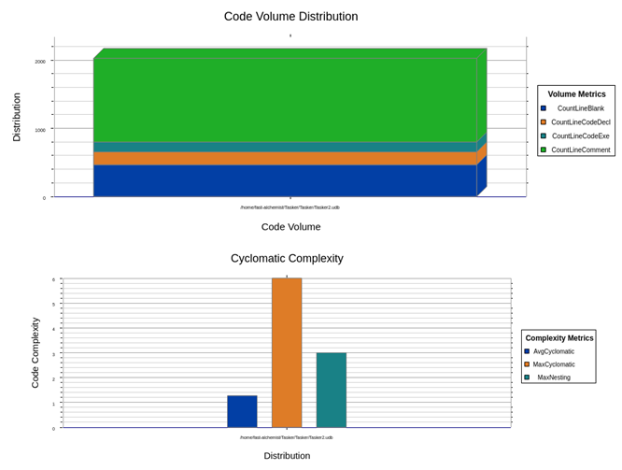
Understand
Blank Lines 465
Classes 20
Code Lines 1,667
Comment Lines 1,227
Comment to Code Ratio 0.74
Declarative Statements 625
Executable Statements 149
Files 44
Functions 162
Inactive Lines 67
Lines 3,687
Preprocessor Lines 301

Slide 13
Known Bugs
Dammit

Slide 14
Known Bugs
2-10s delay on the hardware listeners (due to performance concerns)
We had to sleep our threads to not monopolize CPU usage
Keyboard listening only works on Lunix, and requires super-user (sudo) permissions (security concern)
The input sensitivity, when set to 0%, produces a different value when AudioListener reports the signal value back, depending on the microphone type. Tested with the MacBook Pro’s internal microphone and an Audiobox USB sound card. Solution/hack around this was to “profile” the mic and subtract what we figure is 0% audio from the input gathered.

Slide 15
Lessons and takeaways
Communication is key; tell people if you can’t make something happen
Threads are tricky!
Test-driven development forces programmers to find bugs early

Slide 16
THANKS!
Any questions?
Presentation template by SlidesCarnival
Photographs by Startupstockphotos

